Slide 1
MANAGING LABOUR USING PARTOGRAPH
Dr Nahurira Doreck

Slide 2
PARTOGRAPH
Graphical recording of maternal and fetal well being and progress of labour during normal labour.
Developed by WHO in1970.
Inexpensive and effective
It has transformed the subjective management of labour into more objective exercise.

Slide 3
PARTOGRAPH
Who can use it?
    All trained skilled birth attendants.
When to use it?
    From the start of active phase of first stage of labour.

Slide 4
ADVANTAGES OF PARTOGRAPH
A useful tool to assess the progress of labour
Clearly differentiate normal from abnormal progress in labour
Influences obstetric decision making
Prevent prolonged and obstructed labour and its complication
Reduces the incidence of maternal mortality and morbidity and perinatal mortality

Slide 5
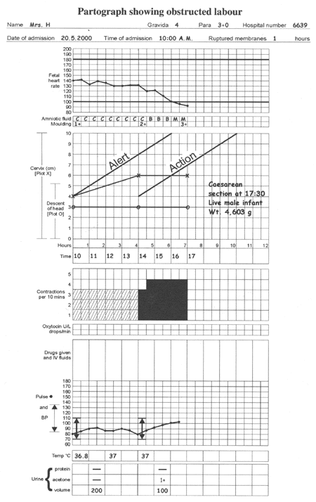
THE PARTOGRAPH
Assessment of fetal wellbeing
Assessment of maternal wellbeing
Assessment of progress of labour

Slide 7
MEASURING FETAL WELLBEING DURING LABOUR
Fetal heart rate and pattern
Degree of molding and caput
Color of amniotic fluid

Slide 8
MEASURING MATERNAL WELLBEING DURING LABOUR
Pulse, temperature, blood pressure, respiration
Urine output, ketones, proteins

Slide 9
MEASURING PROGRESS OF LABOUR
Cervical dilatation
Descent of presenting part
Contractions
Alert and action lines

Slide 10

USING THE PARTOGRAPH
Patient information: Name, Gravida, Para, Hospital number, Date and time of admission and time of ruptured membranes.
Fetal heart rate: Record every ½ hrs.
Amniotic fluid: Record the color at every vaginal examination
    I: Membrane intact
    C: Membrane ruptured, clear fluid
    M: Meconium staining
    B: blood stained fluid

Slide 11
USING THE PARTOGRAPH
Moulding:
    Suture apposed
    Suture overlapped and reducible
    Suture overlapped and not reducible
Cervical dilatation: Assess at every vaginal examination, mark with cross (x)
Alert line: Line starts at 4 cms of cervical dilatation to the point of expected full dilatation at the rate of 1cm/hr
Action line: Parallel and 4 hrs to the right of the alert line

Slide 12
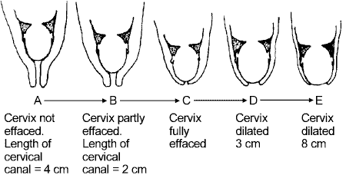
MEASURING PROGRESS OF LABOUR-1
Effacement and dilatation of the cervix

Slide 13
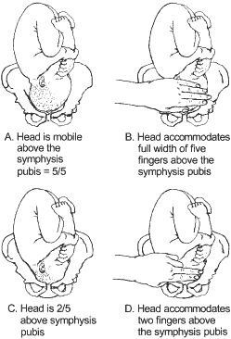
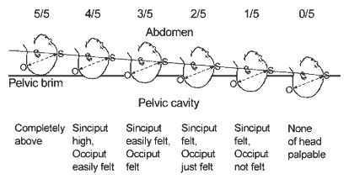
MEASURING PROGRESS OF LABOUR-2
Descent of fetal head
assessed by abdominal palpation

Slide 14
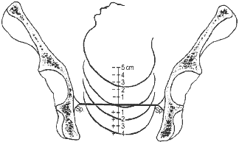
MEASURING PROGRESS OF LABOUR-3
Assessing descent of the fetal head by vaginal
examination; 0 station is at the level of the ischial spine

Slide 15
MEASURING PROGRESS OF LABOUR-4
Contractions: Chart every half hour; palpate the number of contractions in 10 minutes and their duration in seconds.
  Less than 20 seconds:
  Between 20 and 40 seconds:
  More than 40 seconds:

Slide 16
USING THE PARTOGRAPH
Temperature: Record every 2 hours
Pulse: Record every 30 minutes and mark with a dot ( . )
Blood pressure: Record every 4 hours and mark with arrows

